Slide 1

Chandra X-ray Observatory
HRC Anomaly on 24 August 2020
Preliminary Findings & Recommended Actions
Chandra Community Briefing, 26 August 2020
HRC Operations Team
D. Patnaude, R. Kraft, P. Nulsen, G. Tremblay, T. Gauron, A. Kenter, G. Austin, J. Chappell

Slide 2
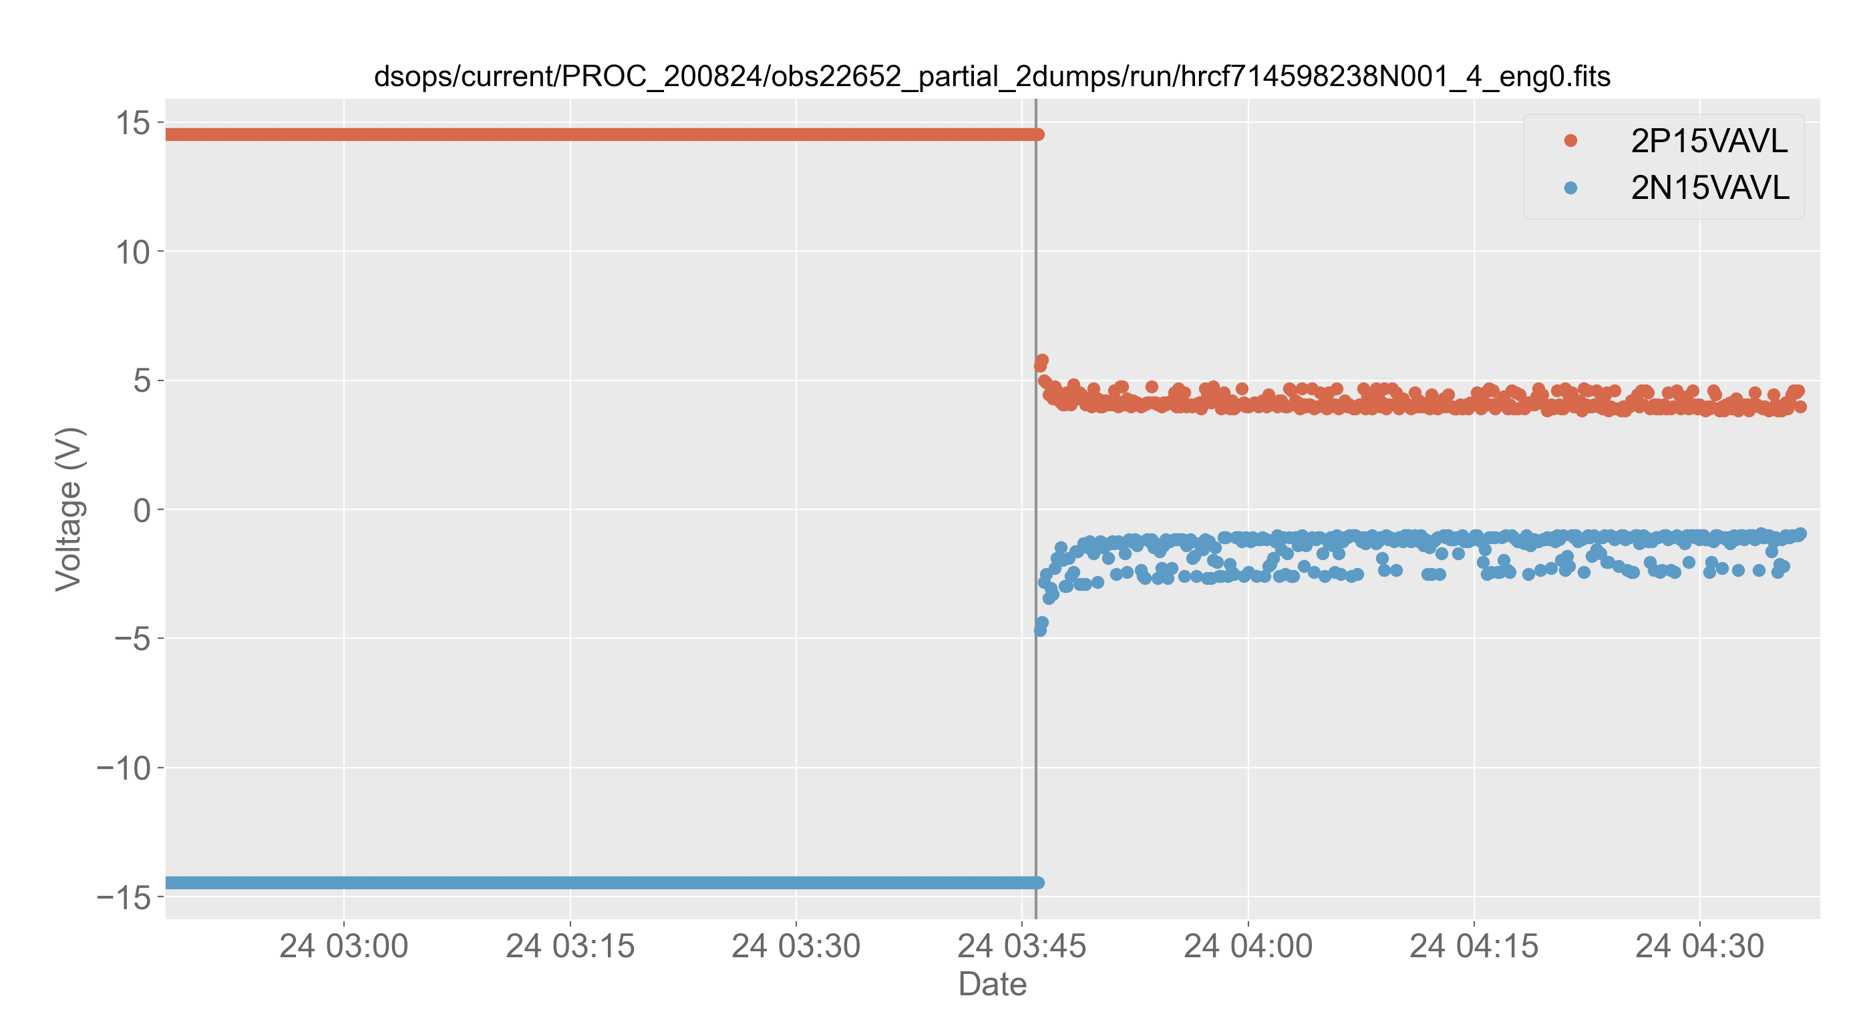
Timeline of Events
At the start of Monday morning’s comm pass, HRC limit violations were noted in the +15V and -15V bus voltage monitors.
At the time, the HRC was not observing and was at half voltage (as expected). The selected detector was HRC-I. Shield rates were nominal. The HRC has not observed for the past ~week, and all telemetry prior to the anomaly has been normal.
Anomaly occurs at 03:45:54 UTC on August 24
+15 V bus monitor drops to ~+4 V
+-15 V bus monitor drops to ~-2 V
Reading scatter also increases dramatically

Slide 3
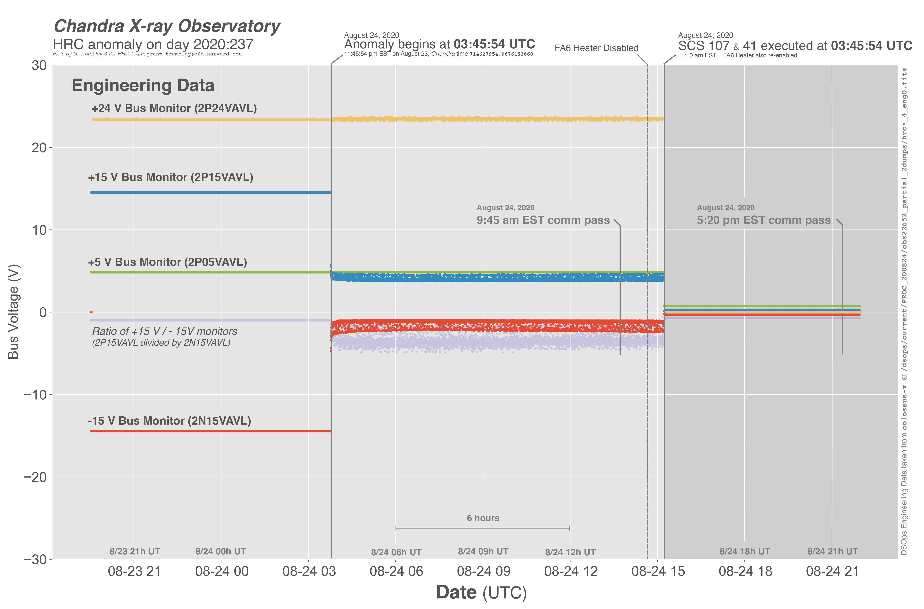
The full event

Slide 4
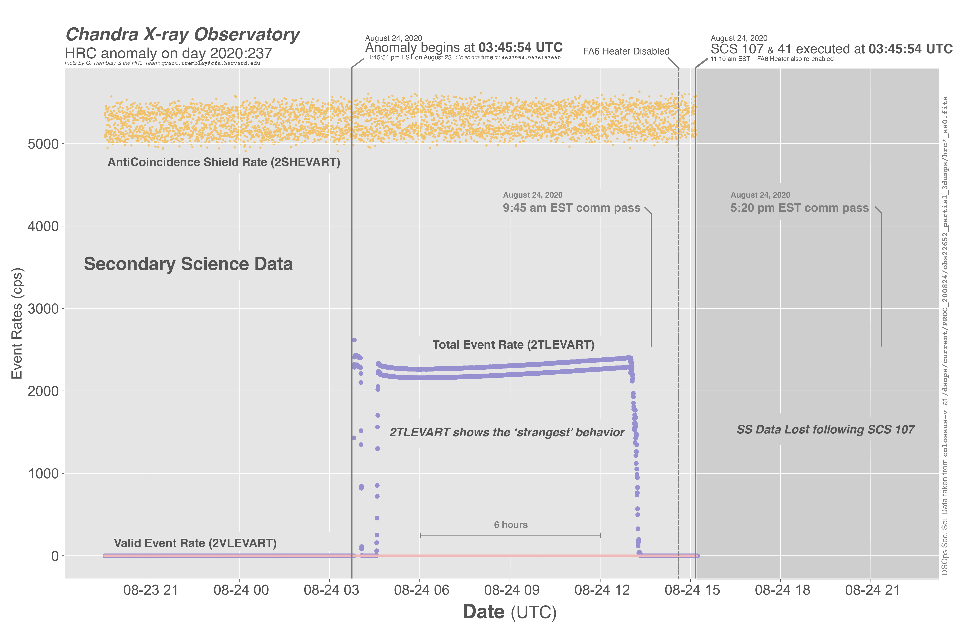
Notes:
TOM HAS AN EXPLAINER FOR THIS WONKY TOTAL EVENT RATE BEHAVIOR

Slide 5
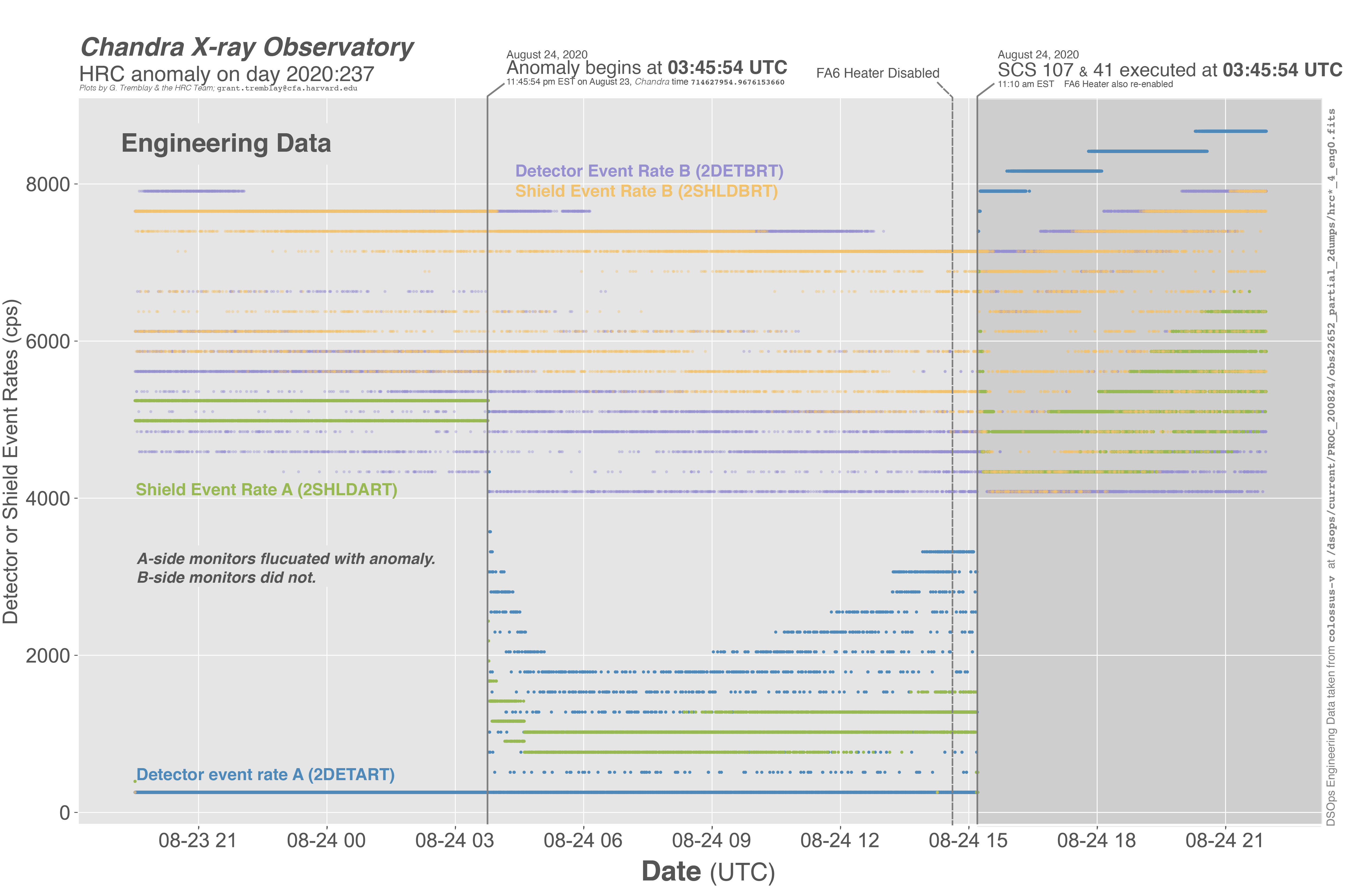

Slide 6
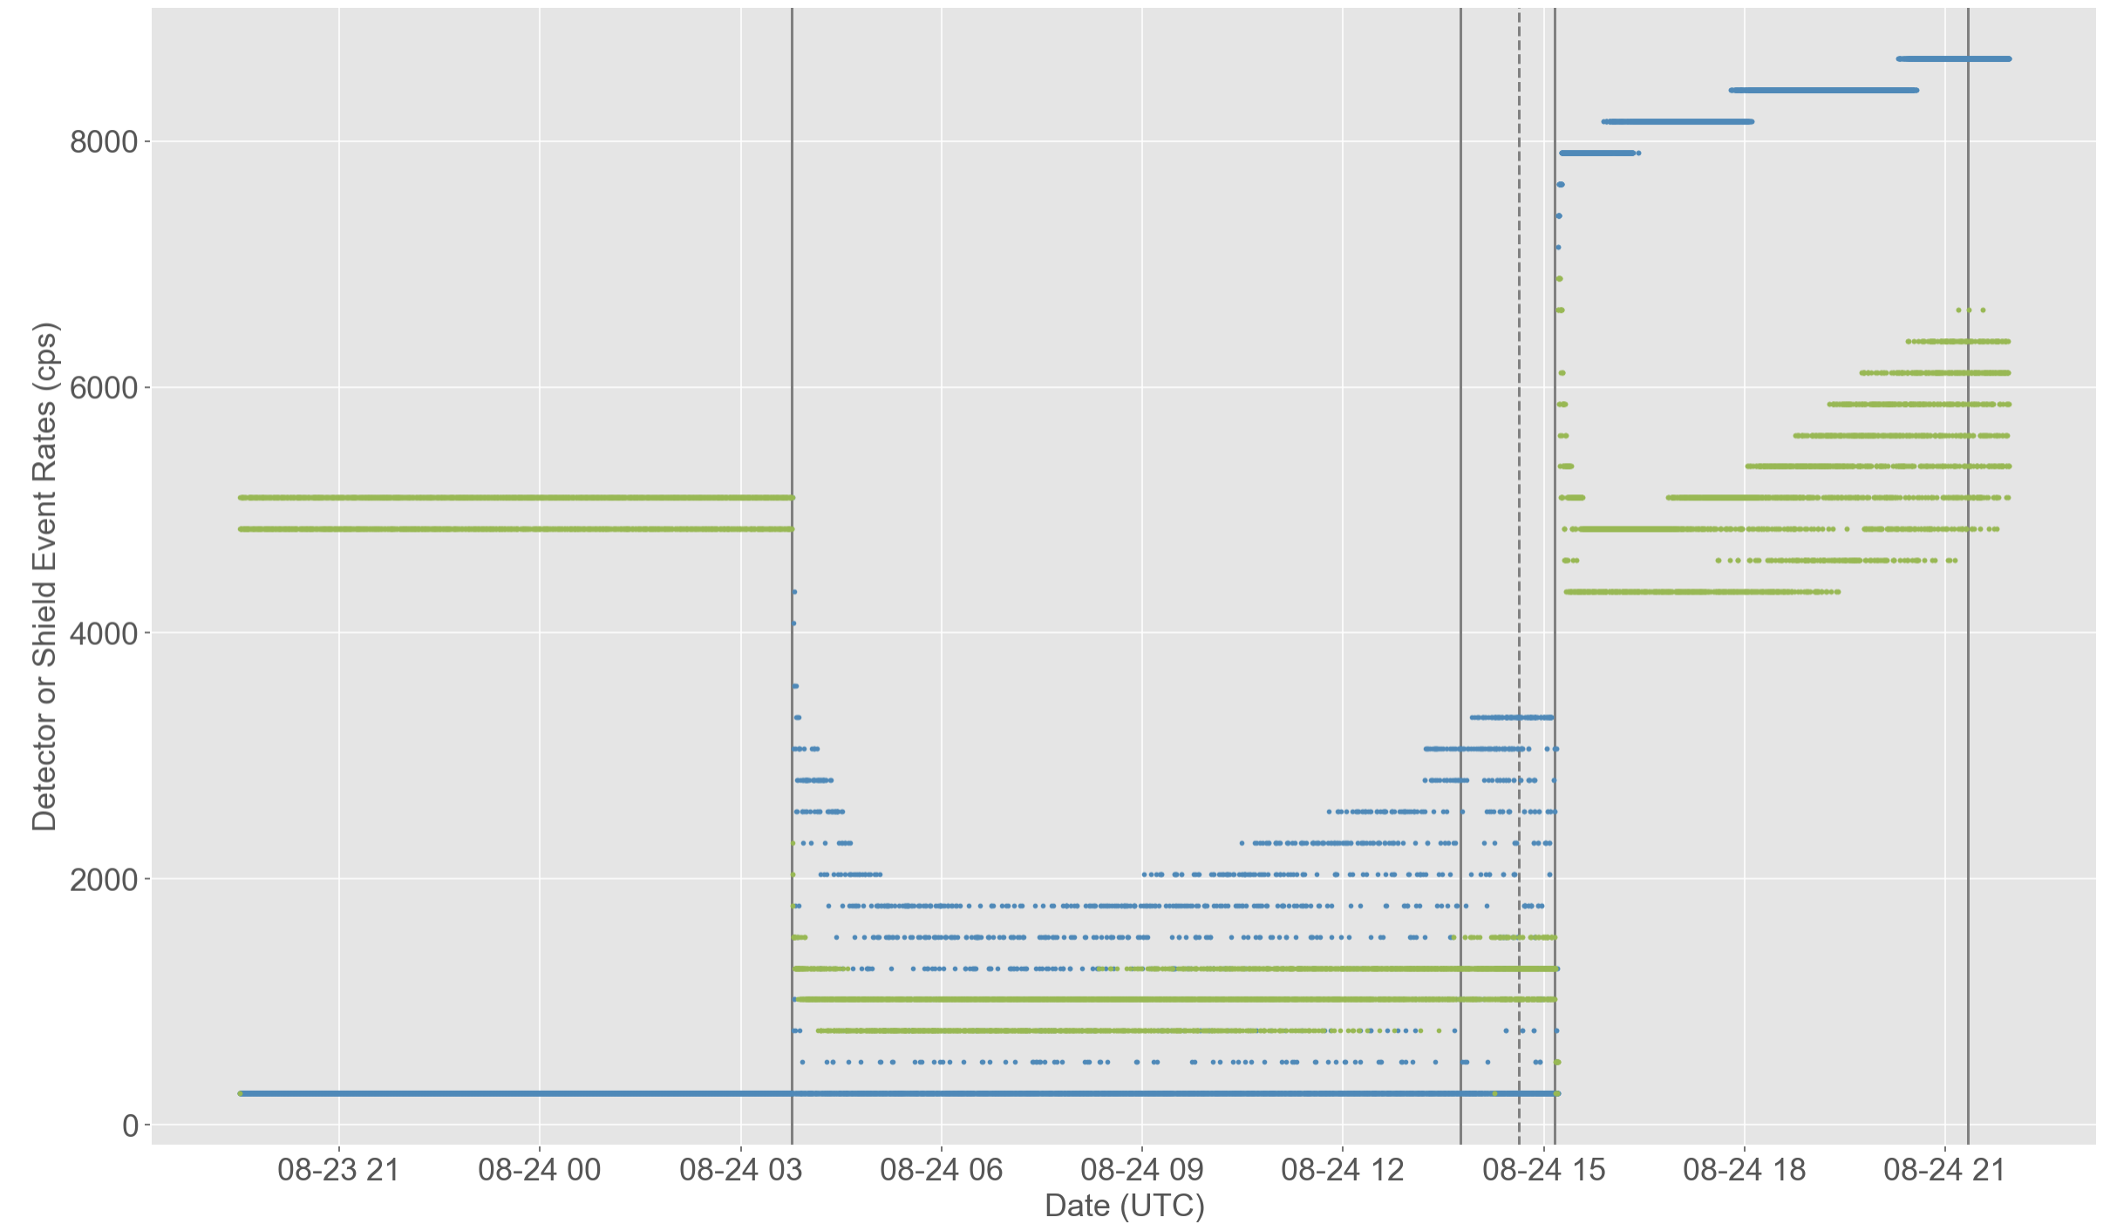
2SHLDART
Shield event rate A
2DETART
Detector event rate A

Slide 7
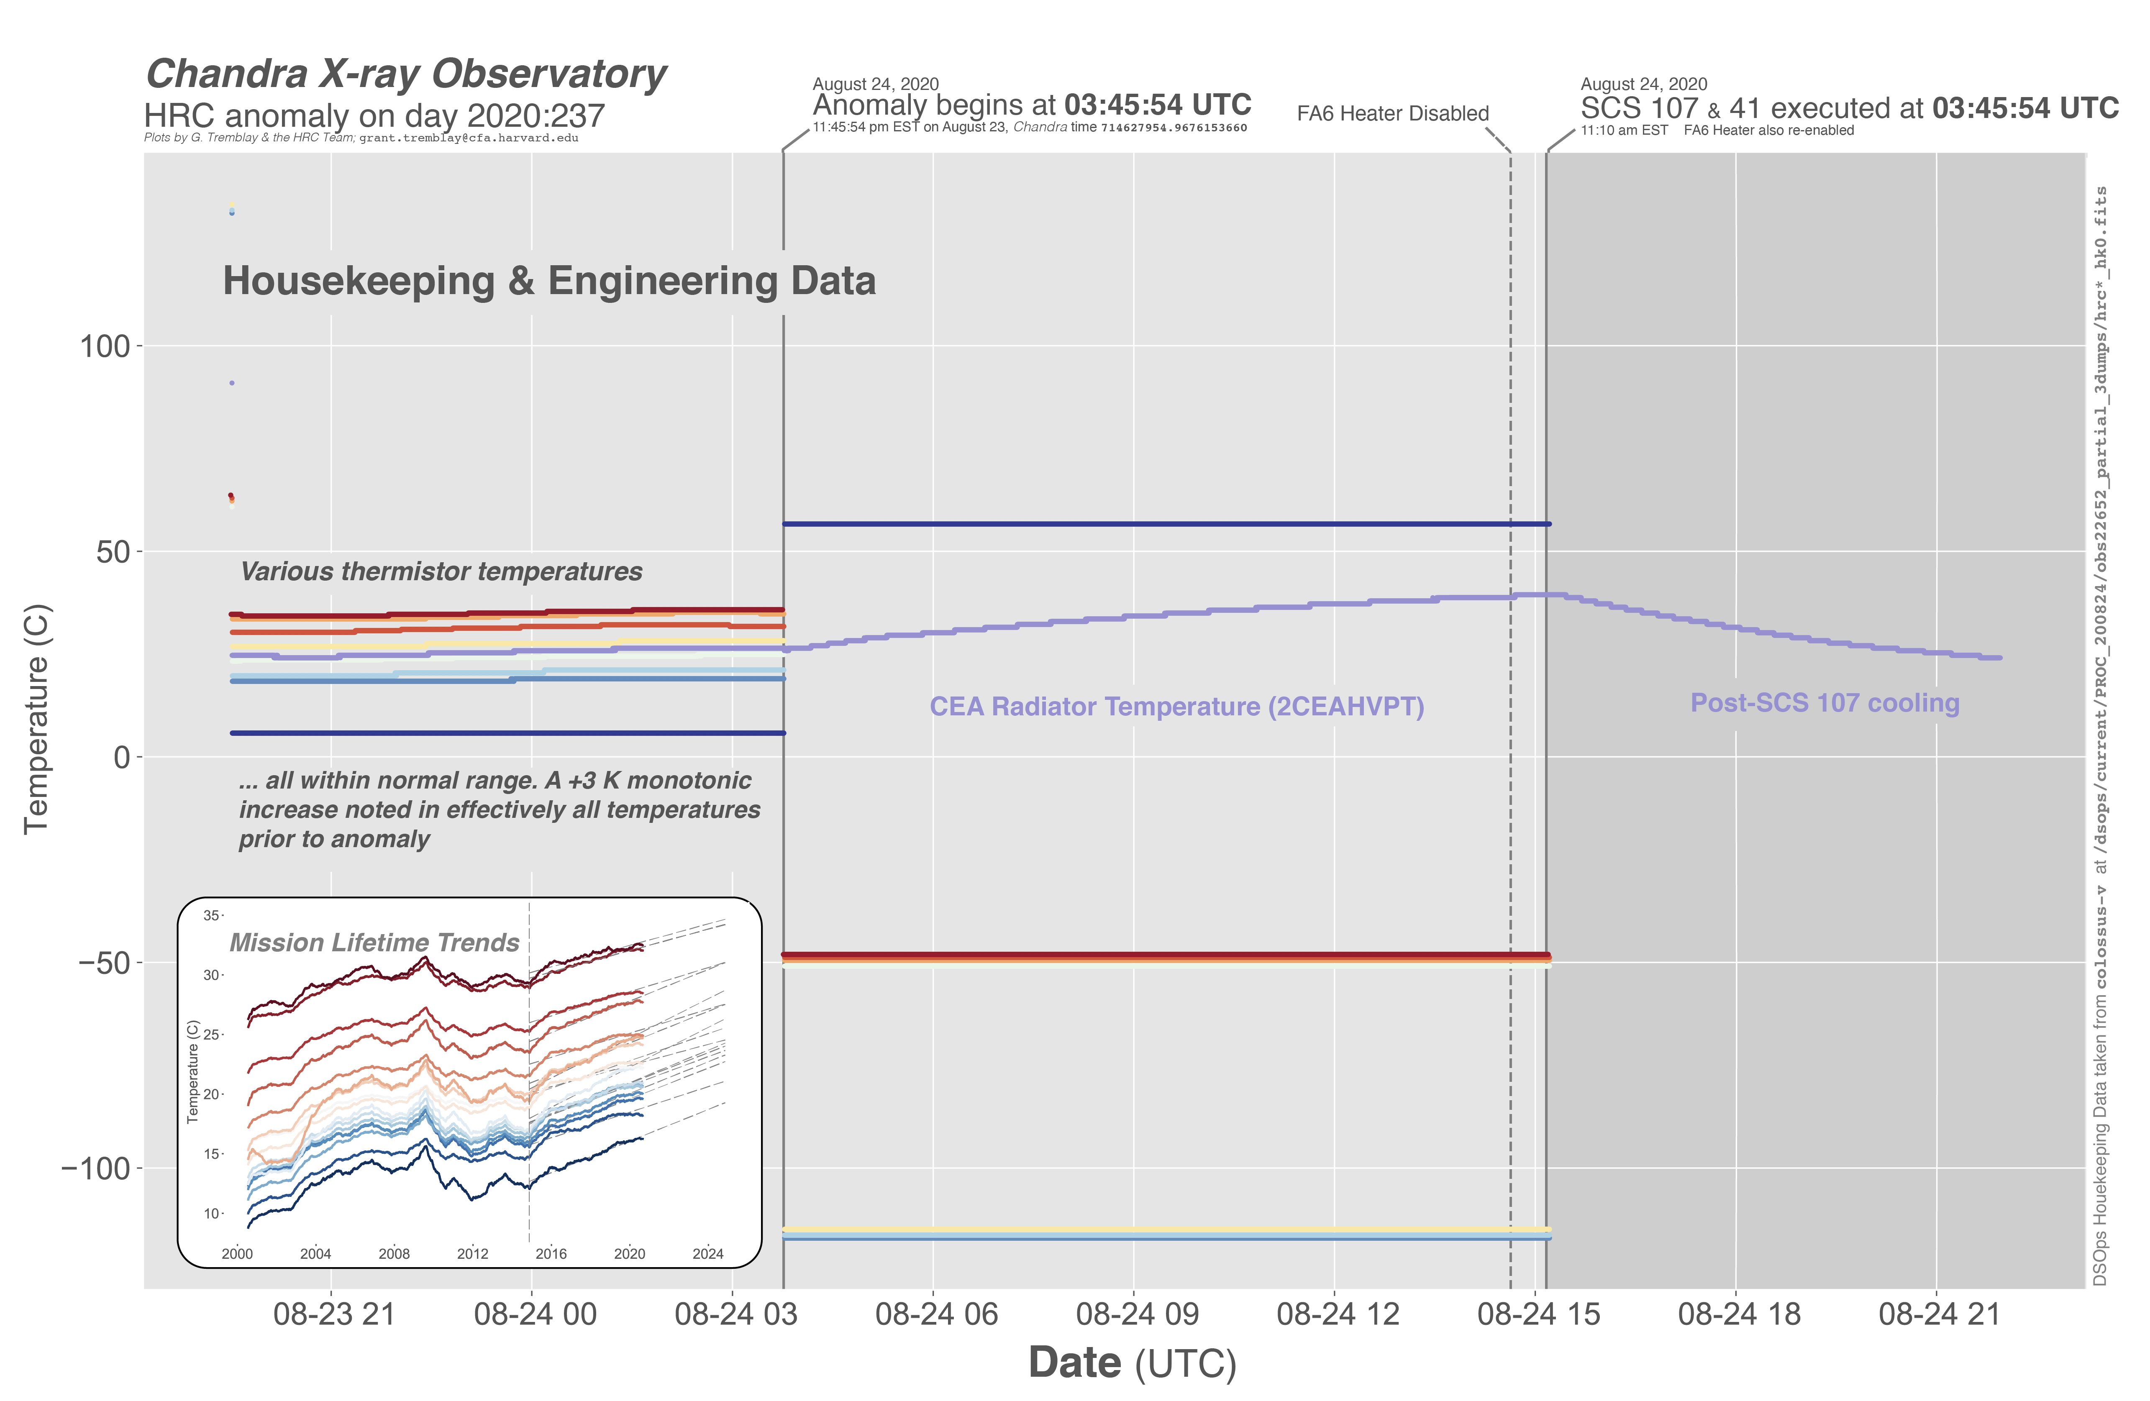

Slide 8
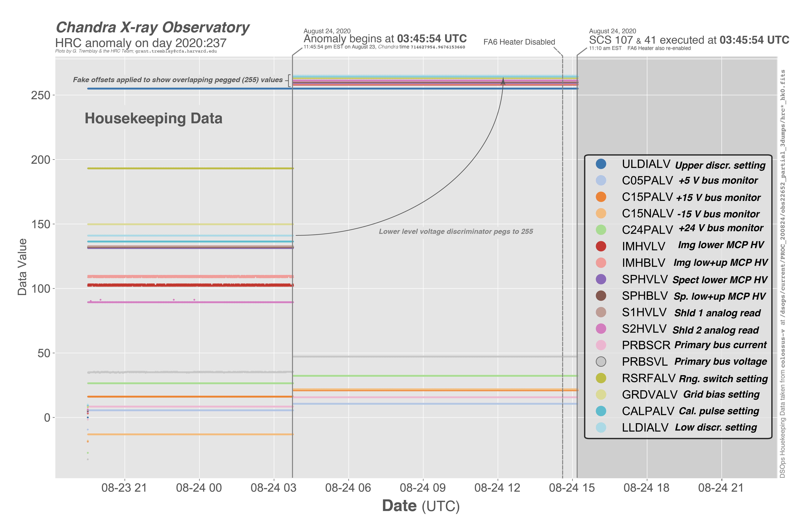

Slide 9
Current Hypotheses
The anomaly is due to a problem with the +/- 15 V power supply bus on Side A
A problem in the +15 V bus would also take out the -15 V power supply due to DC-to-DC design
A problem in the -15 V bus would not cause issues with the +15 V bus
There could be a fault in the electronics on this bus
A load fault that is transient in nature (e.g. an SEL). This should clear with a power cycle.
OR
A failed component that is dragging down the +15V bus. This would not clear with a power cycle and would require an A/B change somewhere.
OR
A latched-up DC-DC converter may clear with power cycle. Otherwise an A / B swap is indicated.

Slide 10
Recommended actions
The HRC team recommends that we attempt a reset of the Side A electronics on the +/- 15 V power supply
A CAP for this procedure is now written and ready for review. It is straightforward, and has back-out pathways at several steps.
Pending a successful CAP review today, we are ready to execute it tonight (pending DSN availability).
The procedure is considered low-risk and reversible. Chances of causing damage to the instrument are very low.
If a Side A reset does not return voltages to nominal values, we will execute SCS 41 to power off the instrument again and make plans to swap to Side B.
We have already begun preparing an activity for a swap to Side B

Slide 11
Why is a Side A reset preferred?
Resetting Side A is lower risk than swapping to Side B.
This is a straightforward path to resumption of science.
Swapping to Side B is a more complicated intervention:
The work required would be roughly equivalent to re-doing orbital activation
Swapping to Side B carries significantly more risk:
It requires movement of a physical relay switch that has not moved in 20 years
“Two plans are better than one”
If our attempt to reset Side A fails, we can then move to “plan B”, and swap to the redundant side.
Attempting to reset Side A first is a low-risk intervention
The CAP is already developed and ready for CAP review and potential execution tonight
We will learn more about the state of the instrument, and test possible hypotheses
We have clean “back-out” pathways at every step in the CAP.

Slide 12
EXTRA SLIDES

Slide 13
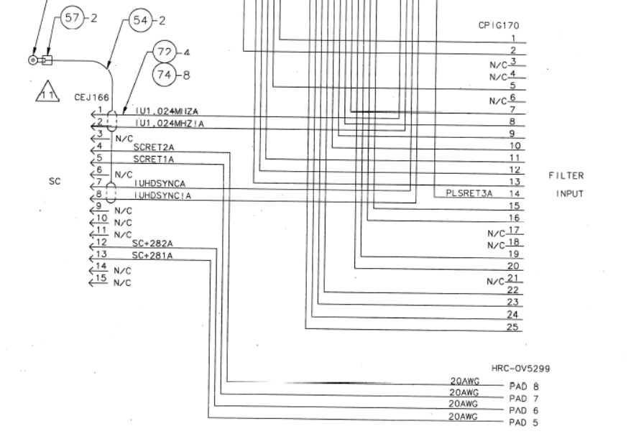
Side B Electronics are identical to Side A

Slide 14
Timeline of Events
At Monday morning’s (BOT 9:45am EST) comm pass, HRC limit violations were noted in the +15V and -15V bus voltage monitors
CEA box temp showed caution high violation
HRC was not observing and was at half voltage (as expected). Selected detector was HRC-I. Shield rates were nominal.
HRC has not observed in the past ~week. Telemetry in the last week has looked normal (until today).

Slide 15
Chandra community briefing from the HRC team
ROUGH TIMELINE
At the morning (BOT 9:45am EST) comm pass, HRC limit violations were noted in the +15V and -15V bus voltage monitors
CEA box temp showed caution high violation
HRC was not observing and was at half voltage (as expected). Selected detector was HRC-I. Shield rates were nominal.
HRC has not observed in the past ~week. Telemetry in the last week has looked normal (until today).

Slide 16
ACTIONS TAKEN
FA6 heater manually commanded off at 10:38 AM local, because the +5V bus was still on (i.e., the HRC was still largely powered-up). Instrument team recommended to turn the heater off.
Around 11:10 AM, SCS 107 and SCS 41 were manually run to safe the instrument. FA6 heater was re-enabled.
Since the morning briefing, the HRC team has been working to analyze the issue and suggest potential next actions.

Slide 17
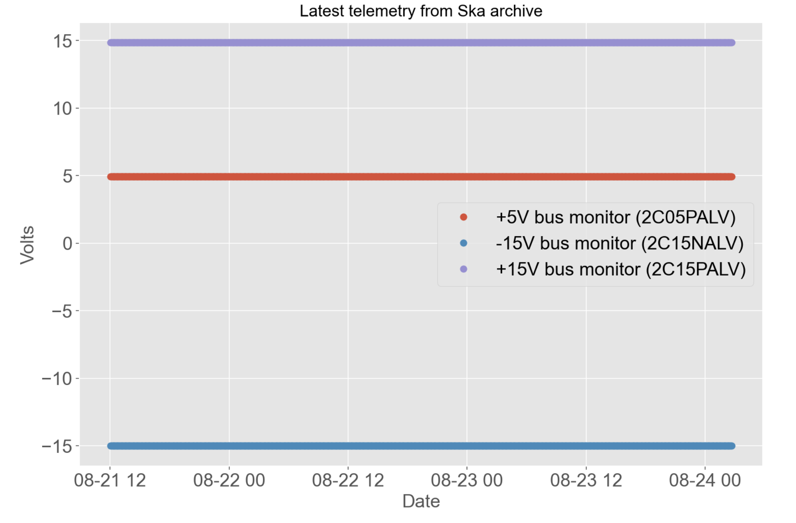
HRC telemetry prior to event has been normal.
HRC has not observed in the past week.
+15 V Bus Monitor
5 V Bus Monitor
-15 V Bus Monitor
Full-resolution Ska data from August 21-24

Slide 18
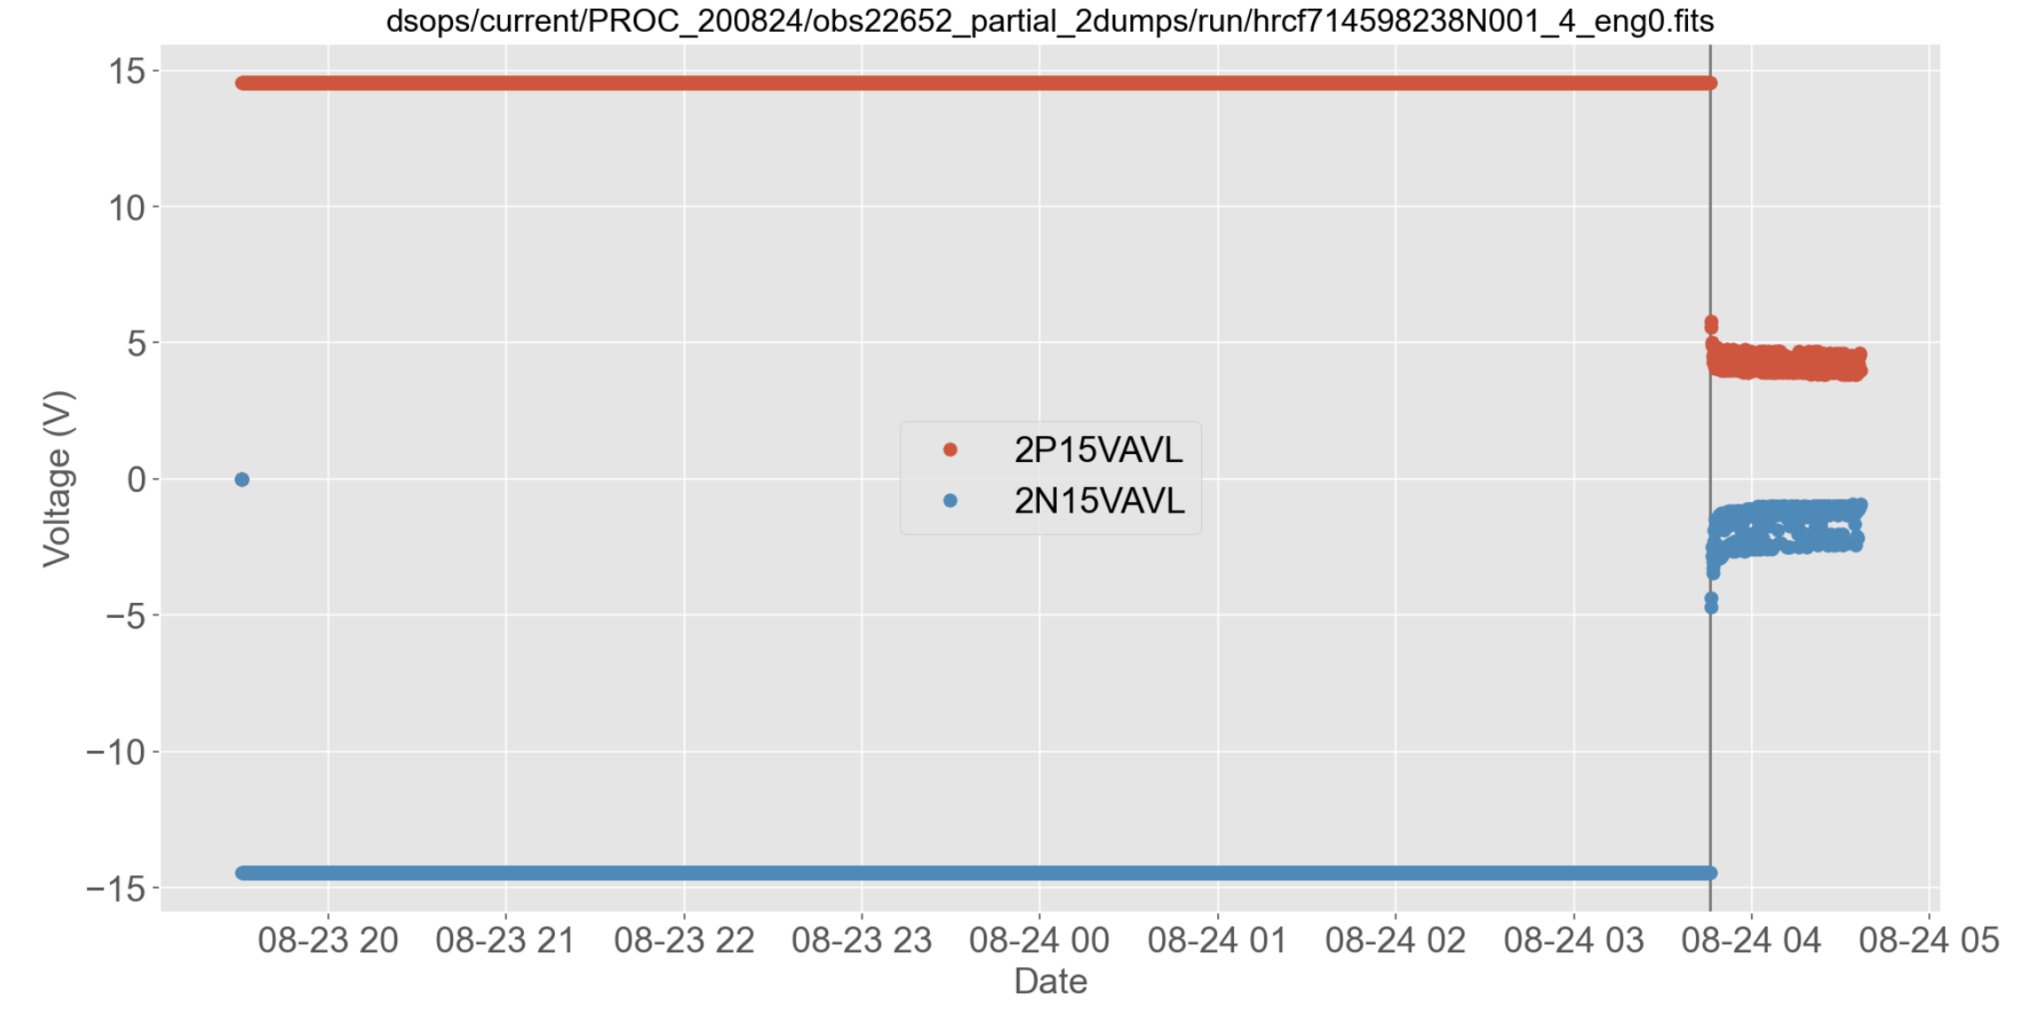
Step change in telemetry at August 24 03:45:54 UTC
+15 V Bus Monitor
-15 V Bus Monitor
Full-resolution Ska data from August 21-24
Notes:
Event at Chandra Time 714627954.9676153660

Slide 19
+15 V Bus Monitor
Step change in telemetry at August 24 03:45:54 UTC
-15 V Bus Monitor
Notes:
Event at Chandra Time 714627954.9676153660

Slide 20
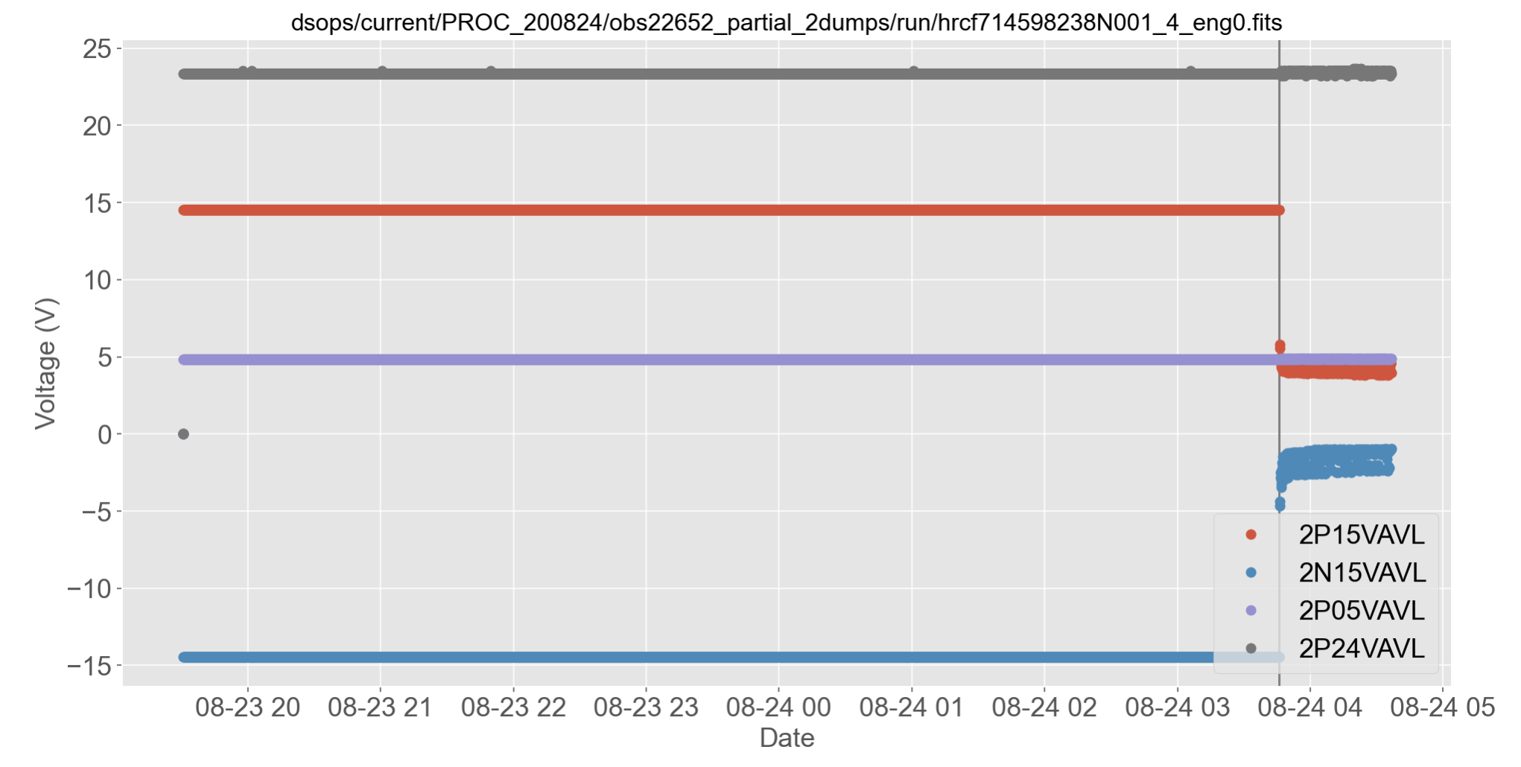
All voltage monitors
24 V Bus Monitor
+15 V Bus Monitor
5 V Bus Monitor
-15 V Bus Monitor

Slide 21
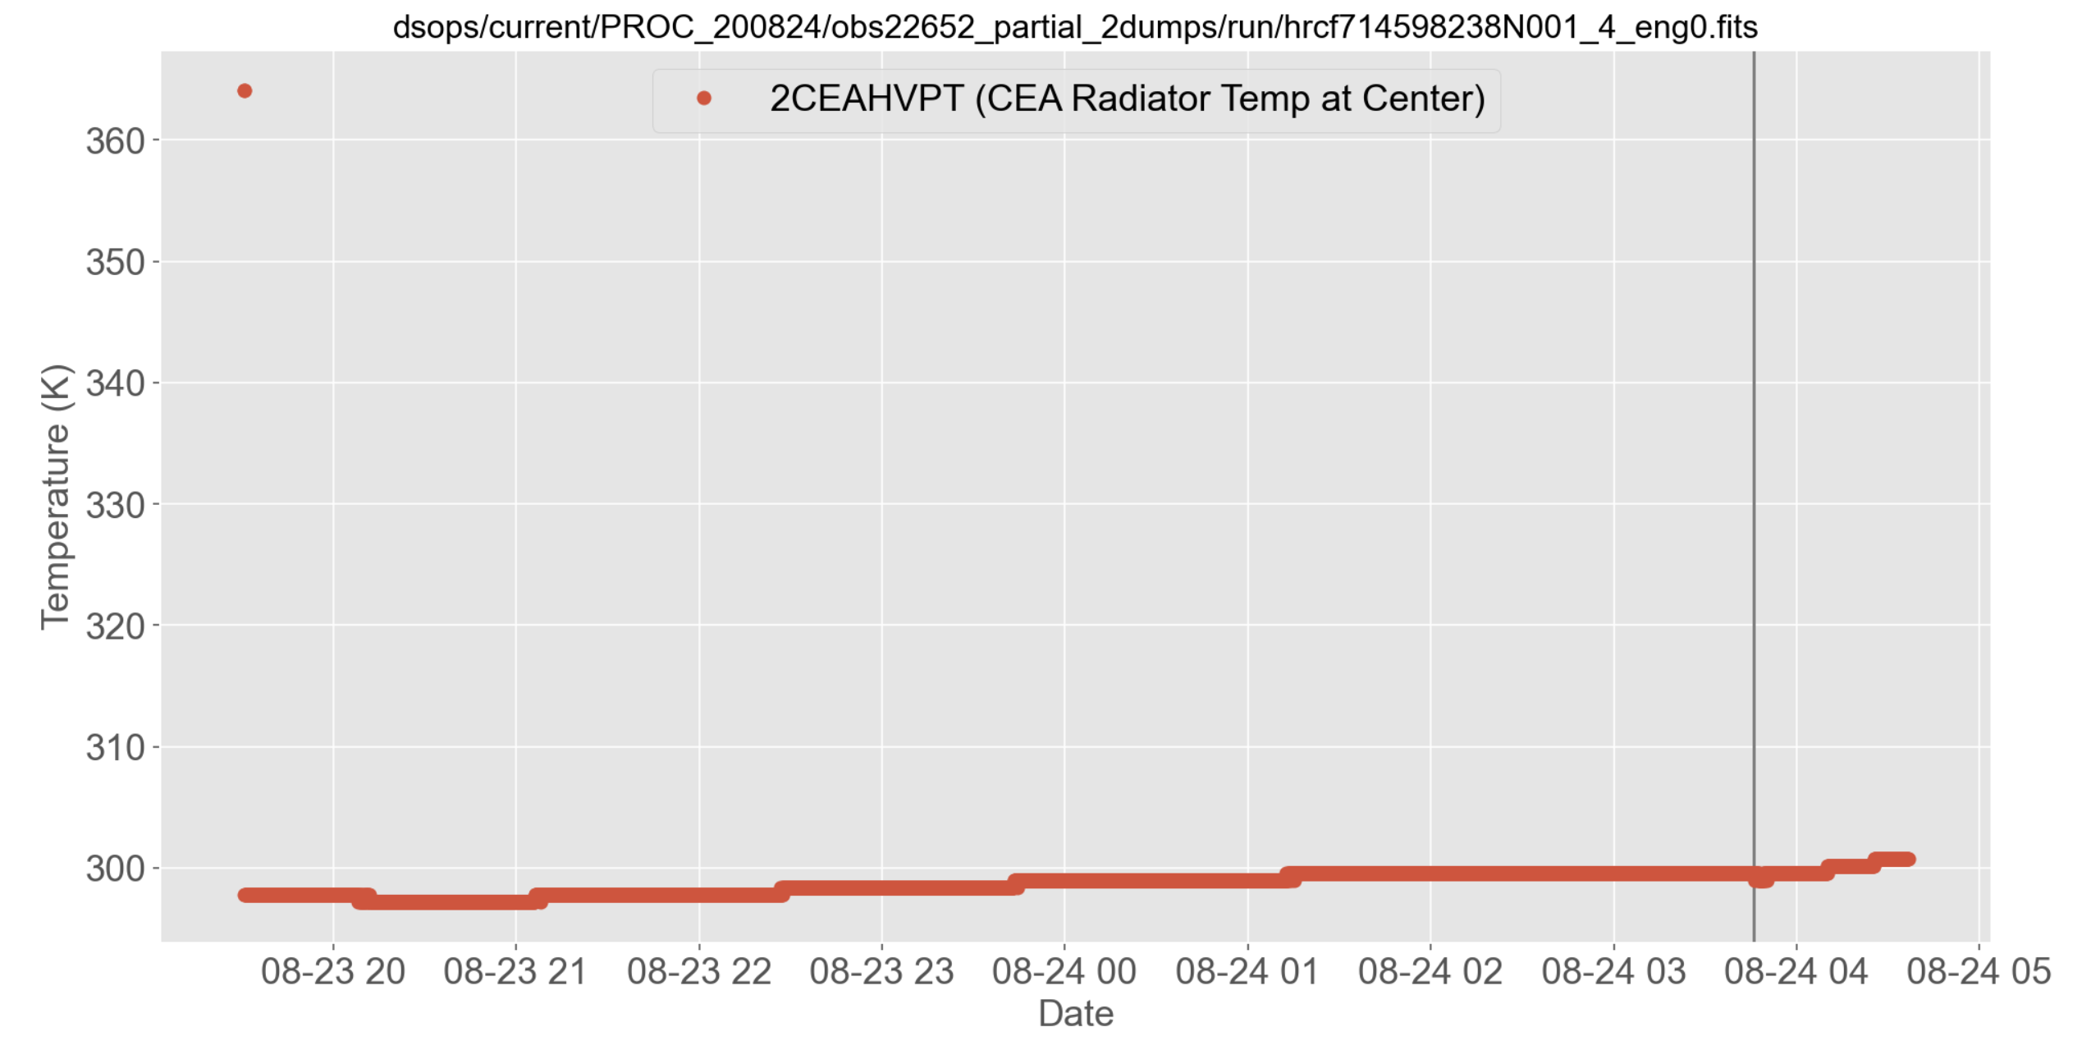
Time of event
CEA Radiator Temperature
Notes:
Event at Chandra Time 714627954.9676153660

Slide 22
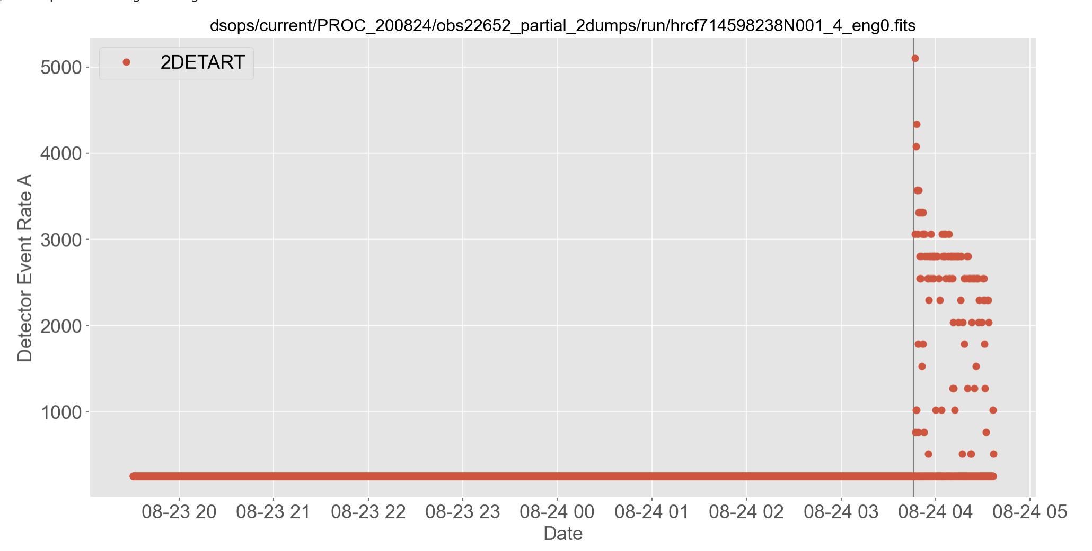
2DETART (HRC detectors were off)
DETECTOR EVENT RATE A

Slide 23
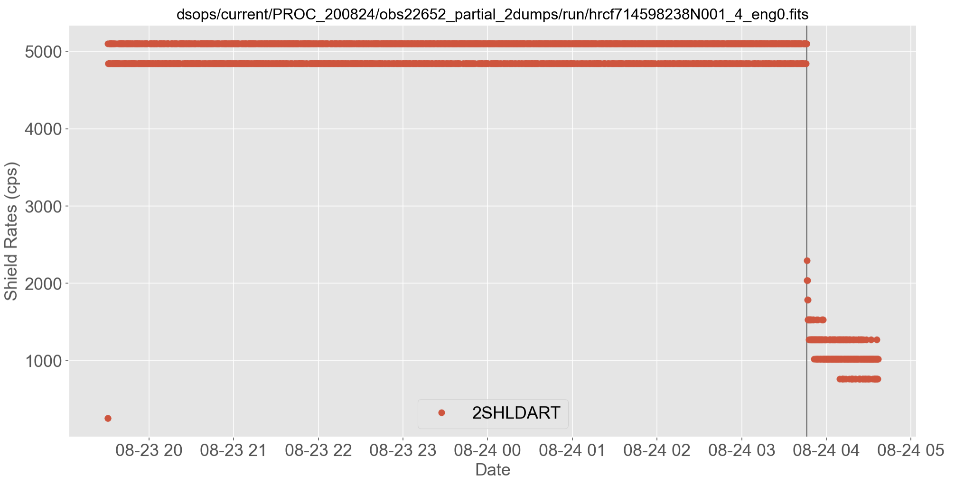
2SHLDART
SHIELD EVENT RATE A

Slide 24
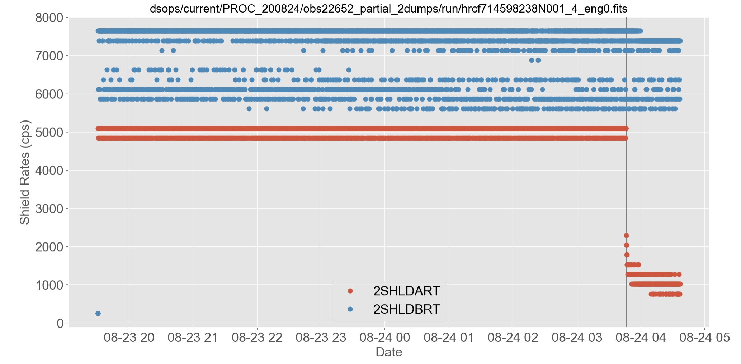
2SHLDBRT
2SHLDART
SHIELD EVENT RATE A

Slide 25
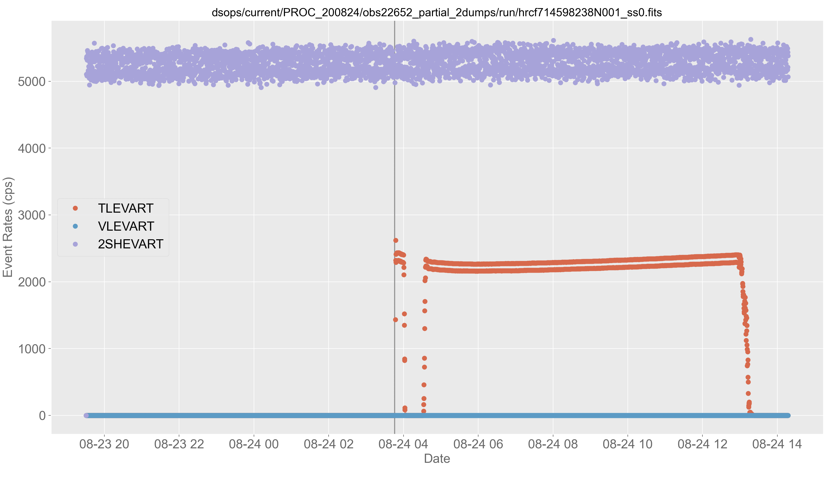
2SHEVART
SHIELD EVENT RATE
2TLEVART
TOTAL EVENT RATE
2VLEVART
VALID EVENT RATE (ALWAYS ZERO)

Slide 26
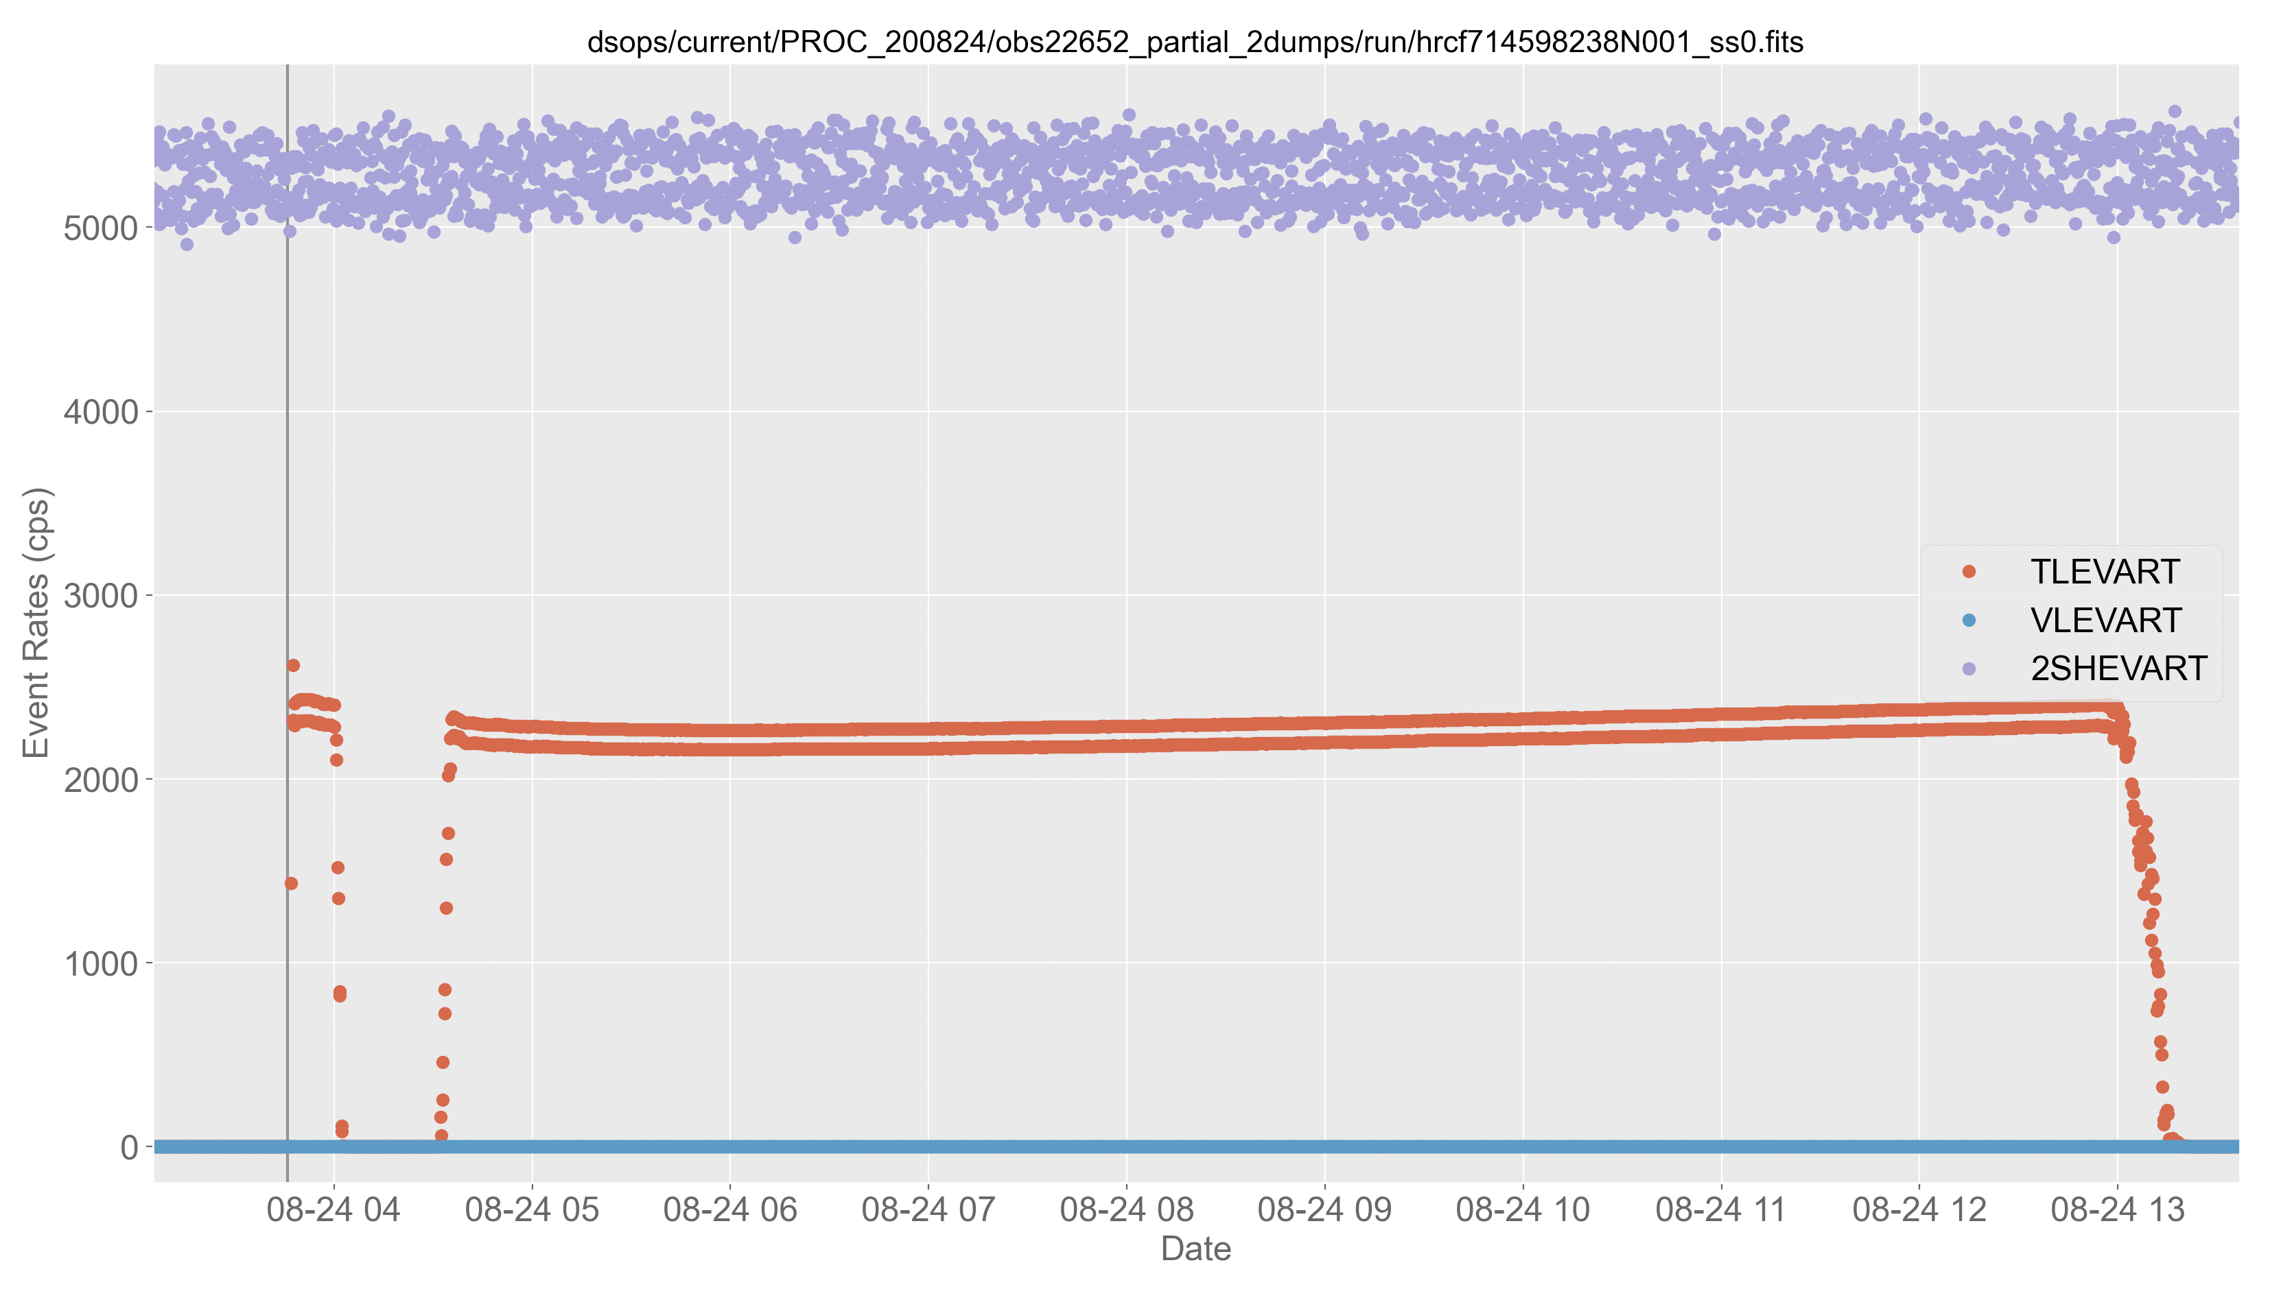
2TLEVART
TOTAL EVENT RATE

Slide 27
RECOMMENDED ACTIONS
A controlled power-on of the HRC
We will need to work with the FOT on this
At this time, we would advise against turning the HRC on simply to activate the shield

Slide 28
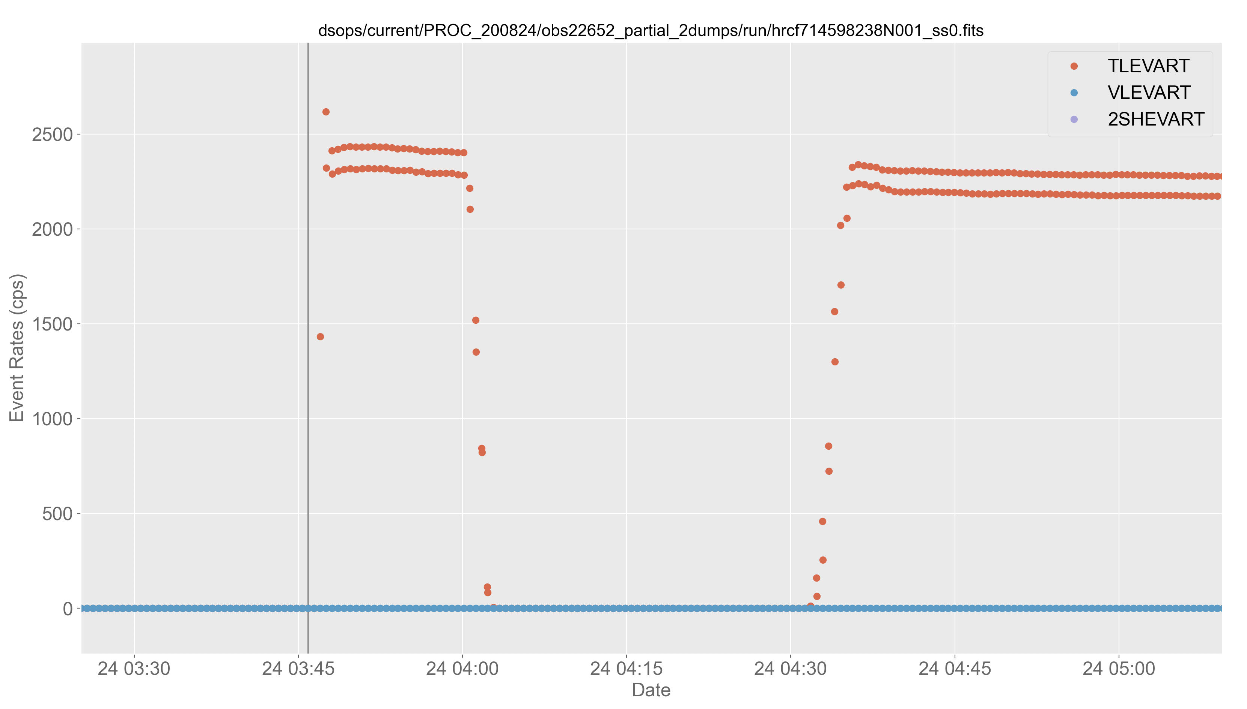
2TLEVART
TOTAL EVENT RATE

Slide 29
